Slide 1
Memory
Operating system lesson 12

Slide 2
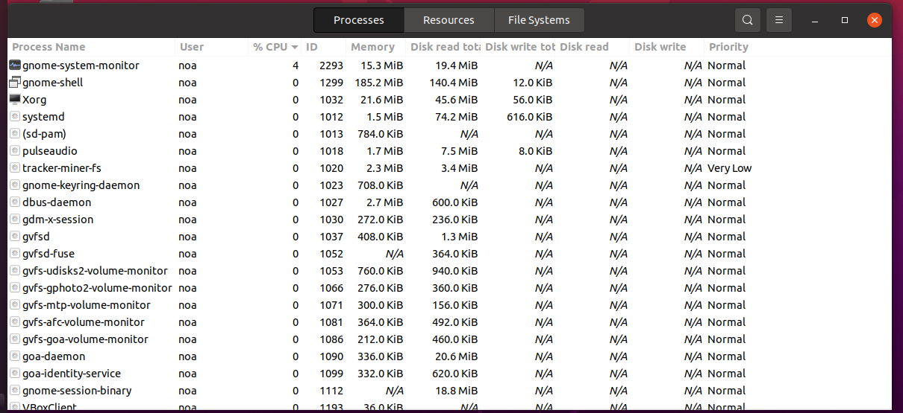
System monitor

Slide 3
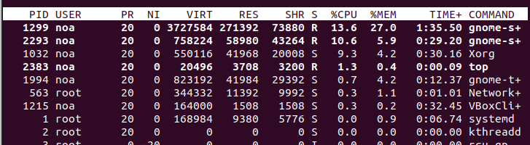
Top
VIRT: Total virtual memory used by the task.
RES: The memory consumed by the process in RAM
%MEM: expresses this value as a percentage of the total RAM available.
SHR: The amount of memory shared with other processes

Slide 4
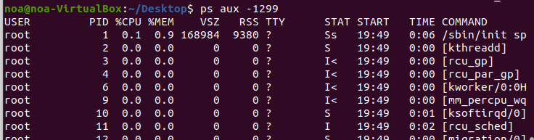
Ps aux
VSZ: Displays amount of virtual memory being consumed by the process
RSS: The actual physical wired-in memory that is being used

Slide 5
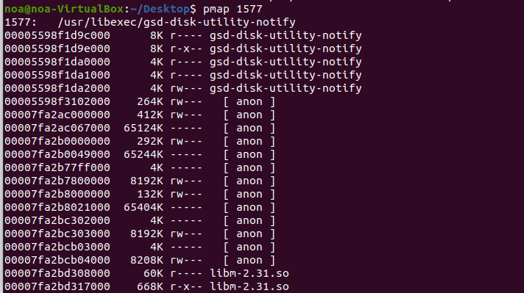
Pmap <pid>

Slide 6
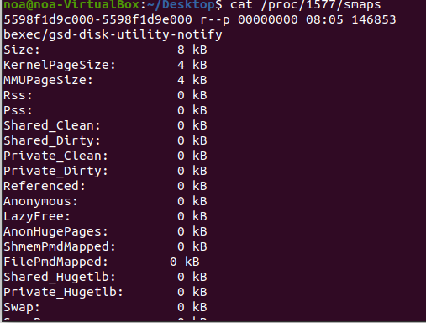
/proc/<pid>/smaps
Cat /proc/<pid>/smaps

Slide 7
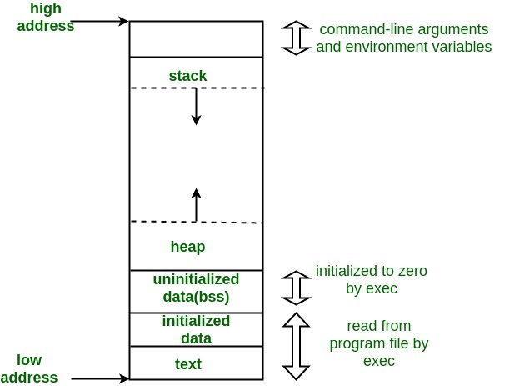
Memory Layout of C Programs

Slide 8
1. Text Segment:
The text segment is the memory area that contains the machine instructions that CPU executes.
Usually, this segment is shared across different instances of the same program being executed. Since there is no point of changing the CPU instructions so this segment has read-only privileges.

Slide 9
2. Initialized Data Segment (data)
A data segment is a portion of the virtual address space of a program, which contains the global variables and static variables that are initialized by the programmer.
contains all global variables and static variables that are initialized to zero or do not have explicit initialization in source code.
3. Uninitialized Data Segment (bss)

Slide 10
4. Stack:
The stack area contains the program stack, a LIFO structure, typically located in the higher parts of memory.
Each time a function is called, the address of where to return to and certain information about the caller’s environment, such as some of the machine registers, are saved on the stack.
where automatic variables are stored

Slide 11
5. Heap:
Heap is the segment where dynamic memory allocation usually takes place
The Heap area is shared by all shared libraries and dynamically loaded modules in a process.

Slide 12
CPU GOVERNOR powersave vs performance cpufreq app
grep -E '^model name|^cpu MHz' /proc/cpuinfo

Slide 13
Task 4

